Slide 1

MINOR PROJECT PRESENTATION - MTE
Real-Time Detection of AI-Generated Speech
Presented By:
Vansh Giri
229303045
CCE – C 6th
Under Guidance Of:
Dr. Vaishali Yadav
Dr. Arpit Kumar Sharma

Slide 2

Introduction
The rise of generative AI has enabled real-time voice cloning, creating both opportunities and security risks. Deepfake voices can be misused for impersonation, fraud, and misinformation, making detection crucial.
This project focuses on developing a real-time AI-generated speech detection system using machine learning. By analyzing real and synthetic voices from a Kaggle dataset, the model aims to ensure trust in digital interactions. The final outcome will be a web-based tool for voice authenticity verification, contributing to AI security and ethical AI use.

Slide 3

Problem Statements
With the rise of AI-driven speech synthesis and deepfake voice generation, fraudulent activities like identity theft and misinformation are increasing. Existing detection methods are either computationally expensive or ineffective in real-time scenarios.
This project aims to develop a lightweight, real-time AI voice detection system that accurately distinguishes between human and AI-generated speech, ensuring security and trust in digital communications.

Slide 4
Requirements Engineering
Functional Requirements:
Develop a machine learning model to detect AI-generated speech.
Process and analyze real and fake audio samples for training.
Implement a web-based tool for real-time voice verification.
Provide a user-friendly interface for easy access.

Slide 5
Requirements Engineering
Non-Functional Requirements:
Ensure real-time processing with minimal latency.
Optimize the model for lightweight deployment.
Maintain high accuracy and robustness against evolving deepfake techniques.
Ensure scalability for broader accessibility and use.

Slide 6

Development and Design
System Architecture:
Frontend (React): Interactive UI for users to upload/record voice and view results.
Backend (Flask): Handles audio processing, ML inference, and API communication.
Machine Learning Model: Classifies audio as real or AI-generated using extracted features.
Database: Stores detection history for analysis.

Slide 7
Development and Design
Best Model Selection:
CSV Data: Random Forest Classifier (highest accuracy).
Feature-Extracted Audio Data: K-Nearest Neighbors (KNN).
Approach Selection: Used ML models on extracted CSV data instead of spectrogram-based CNN models for efficiency.
Model Extraction & Testing:
Extracted and tested multiple models on both CSV data and raw audio feature-extracted data.
Evaluated various models and selected the best-performing ones.
Explored deep learning models but opted for traditional ML models due to lower accuracy and lightweight requirements.

Slide 8
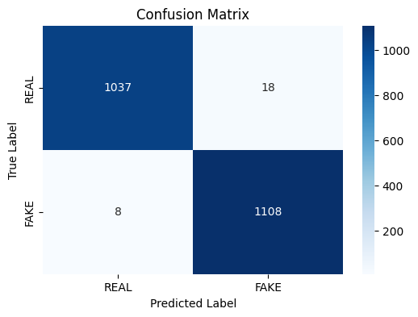
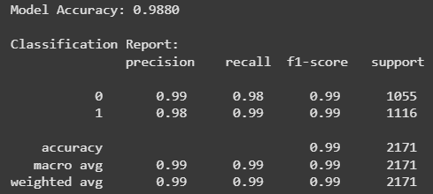
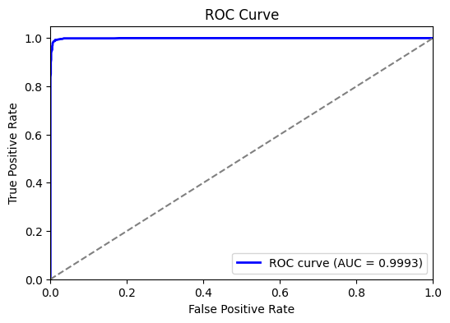
Random Forest Classifier on CSV dataset

Slide 9
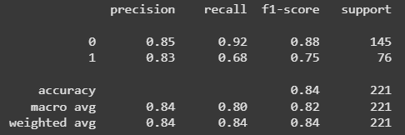
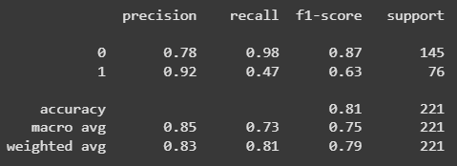
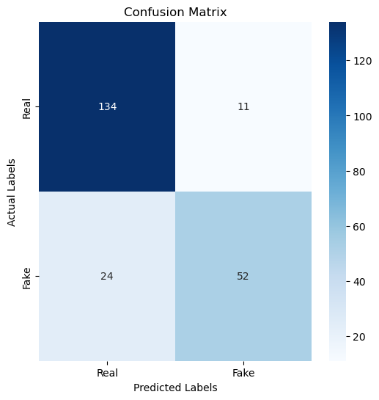
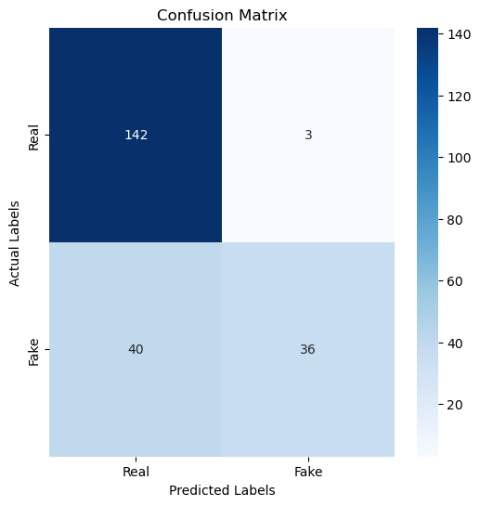
Feature Extracted dataset
Logistic Regr.
SVM

Slide 10
K-Nearest Neighbours Classifier on Feature Extracted dataset

Slide 11
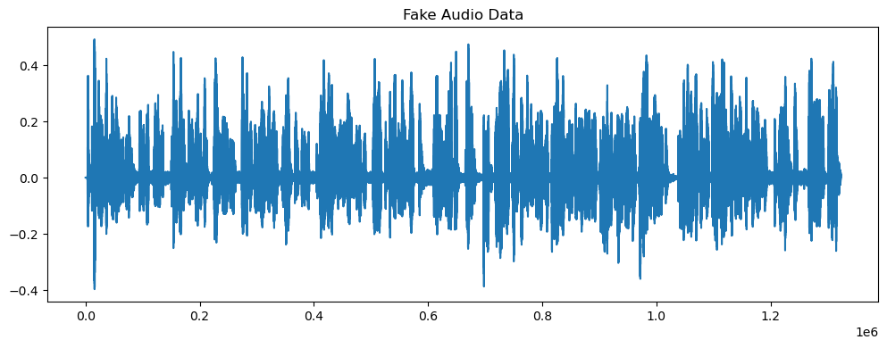
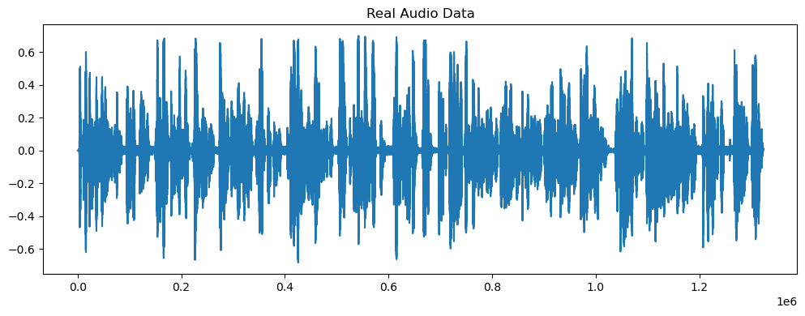
Real vs Fake Audio

Slide 12

Development and Design
Workflow:
User Interaction (React UI): Users upload/record an audio file.
API Request (Flask Backend): React sends audio data to Flask for processing.
Feature Extraction: Flask extracts MFCCs & spectral features using Librosa.
Model Prediction: ML model (Random Forest/KNN) classifies the audio as real or fake.
Result Display: Flask returns results to React, which updates the UI.

Slide 13
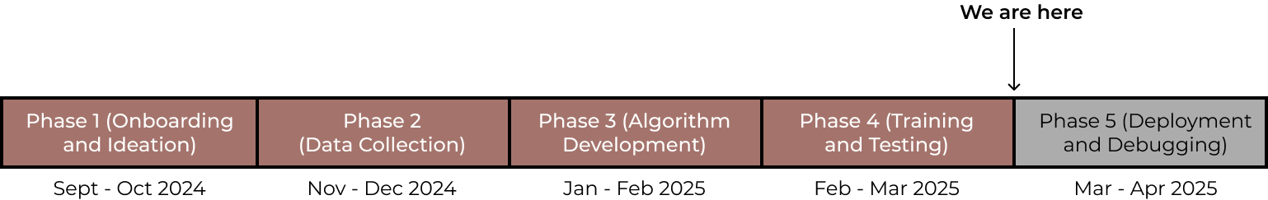
Timeline

Slide 14
Thank You

